Slide 1


Migrating to Angular via ng-metadata

Slide 2


Welcome to Panaya
A SaaS company
Leading the area of impact and risk analysis to ERP systems
Integrating with Salesforce, ServiceNow, SAP, Oracle ERP
Agile workflow for IT And development teams
We have full-stack and data miners teams
We’re hiring!

Slide 3
The Front-End and Me

Slide 4

Our Story Begins…
Running AngularJS 1.4
ECMAScript 5
No Webpack, No NPM
Our DNA always want to gain knowledge and implement new technologies
Thus, we want to upgrade to the latest Angular

Slide 5

The Hybrid Solution
Medium+ can’t afford code rewrite
NgUpgrade comes to the rescue (?)
Need a clear road map of migration
Not an end-solution
Performance degradations

Slide 6
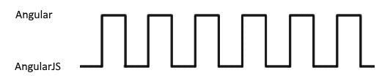
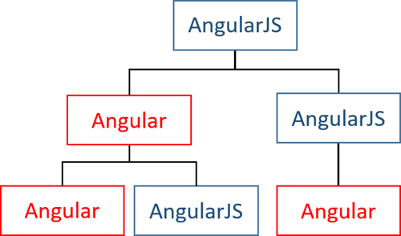
After several months…

Slide 7
The Show Stopper
core.es5.js?de3d:1020 ERROR Error: [$rootScope:inprog] http://errors.angularjs.org/1.4.3/$rootScope/inprog?p0=%24digest
at angular.js:38
at r (angular.js:16200)
at n.$digest (angular.js:15637)
at eval (static.es5.js?fadf:1321)
at SafeSubscriber.schedulerFn [as _next] (core.es5.js?de3d:3647)
at SafeSubscriber.__tryOrUnsub (Subscriber.js?9a65:238)
at SafeSubscriber.next (Subscriber.js?9a65:185)
at Subscriber._next (Subscriber.js?9a65:125)
at Subscriber.next (Subscriber.js?9a65:89)
at EventEmitter.Subject.next (Subject.js?104a:55)

Slide 8
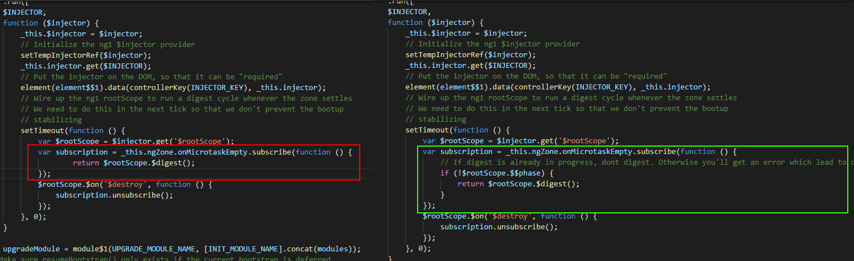
@angular/upgrade/static.es5.js

Slide 9
Thank you

